Slide 1
Models of Linear Operators
Meeting #7
September 10, 2002
September 11, 2003
J.Y.Hung
ELEC 7500/6 State Variable Analysis

Slide 2
Lesson Goals
Defining a Linear Operator
Representing a Linear Operator
Linear Operator under a Change of Basis
Application to State Variable Models
Reference: Brogan,Chapter 5.11
J.Y.Hung
ELEC 7500/6 State Variable Analysis

Slide 3
Operator Concept
Operator A maps vectors from space X to vectors in space Y
X
A
Y
J.Y.Hung
ELEC 7500/6 State Variable Analysis

Slide 4
What is an Operator?
Association of one vector to another one, i.e. a “mapping”
Notation
  A: (X, F) ⇒ (Y, F)
  X is n-dimensional and Y is m-dimensional.
Vector spaces can be different
J.Y.Hung
ELEC 7500/6 State Variable Analysis

Slide 5
Operator Interpretation
A “stretches and rotates” vectors
X
A
Y
J.Y.Hung
ELEC 7500/6 State Variable Analysis

Slide 6
A Linear Operator
Has linearity property
A(α₁x₁+α₂x₂) = α₁A(x₁) + α₂A(x₂)
x₁, x₂ ∈ X α₁, α₂ ∈ F
Also called: Linear Transformation
J.Y.Hung
ELEC 7500/6 State Variable Analysis

Slide 7
Range Space
Range of A (pink part of Y)
R(A)
X
A
Y
R(A)
J.Y.Hung
ELEC 7500/6 State Variable Analysis

Slide 8
“onto”
A is “onto” or “surjective”
means range space is all of Y
X
A
Y
R(A)
J.Y.Hung
ELEC 7500/6 State Variable Analysis

Slide 9
“one-to-one”
A is “1-to-1” or “injective”
means mappings are unique
X
A
Y
J.Y.Hung
ELEC 7500/6 State Variable Analysis

Slide 10
“invertible”
“1-to-1 and onto” or “bijective”
Y
X
A
J.Y.Hung
ELEC 7500/6 State Variable Analysis

Slide 11
Inverse operator
A⁻¹: Y ⇒ X
Note the order!
A⁻¹(A(x)) ∈ X
A(A⁻¹(y)) ∈ Y
J.Y.Hung
ELEC 7500/6 State Variable Analysis

Slide 12
Null Space
N(A) = {x ∈ X such that A(x) = 0}
X
A
Y
0
N(A)
J.Y.Hung
ELEC 7500/6 State Variable Analysis

Slide 13
Model of a Linear Operator
Let basis sets of X and Y be:
e = {e_{i}} , i = 1,…, n
γ = {γ_{j}} , j = 1,…, m
J.Y.Hung
ELEC 7500/6 State Variable Analysis

Slide 14
Model of a Linear Operator (2)
Vector x ∈ X has representation:
x = α₁e₁ + α₂e₂ + · · · + α_{n}e_{n}
α_{i} ∈ F are the coordinates of x relative to the basis set e
J.Y.Hung
ELEC 7500/6 State Variable Analysis

Slide 15
Model of a Linear Operator (3)
Now A(x) = y ∈ Y . In terms of the basis e, the vector y is:
y = A(α₁e₁ + α₂e₂ + · · · + α_{n}e_{n})
J.Y.Hung
ELEC 7500/6 State Variable Analysis

Slide 16
Model of a Linear Operator (3)
Now A(x) = y ∈ Y . In terms of the basis e, the vector y is:
y = A(α₁e₁ + α₂e₂ + · · · + α_{n}e_{n})
= α₁A(e₁) + · · · + α_{n}A(e_{n})
J.Y.Hung
ELEC 7500/6 State Variable Analysis

Slide 17
Model of a Linear Operator (4)
Define y_{i} = A(e_{i}).
Then:
y = α₁A(e₁) + · · · + α_{n}A(e_{n})
J.Y.Hung
ELEC 7500/6 State Variable Analysis

Slide 18
Model of a Linear Operator (4)
Define y_{i} = A(e_{i}).
Then:
y = α₁A(e₁) + · · · + α_{n}A(e_{n})
= α₁y₁ + α₂y₂ + · · · + α_{n}y_{n}
J.Y.Hung
ELEC 7500/6 State Variable Analysis

Slide 19
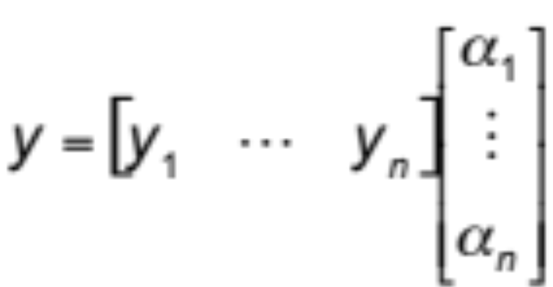
Model of a Linear Operator (5)
Using vector notation:
J.Y.Hung
ELEC 7500/6 State Variable Analysis

Slide 20
Model of a Linear Operator (5)
Using vector notation:
Q: What is y in terms of the basis γ ?
J.Y.Hung
ELEC 7500/6 State Variable Analysis

Slide 21
Model of a Linear Operator (6)
In the basis γ, each y_{i} is given by:
y_{i} = a_{1i}γ₁ + a_{2i}γ₂ + … + a_{mi}γ_{m}
J.Y.Hung
ELEC 7500/6 State Variable Analysis

Slide 22
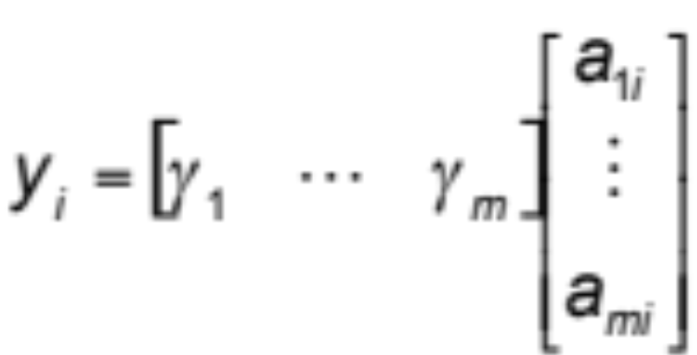
Model of a Linear Operator (6)
In the basis γ, each y_{i} is given by:
y_{i} = a_{1i}γ₁ + a_{2i}γ₂ + … + a_{mi}γ_{m}
or
J.Y.Hung
ELEC 7500/6 State Variable Analysis

Slide 23
Model of a Linear Operator (7)
Substituting representation of y_{i} into y:
(repeating earlier slide)
J.Y.Hung
ELEC 7500/6 State Variable Analysis

Slide 24
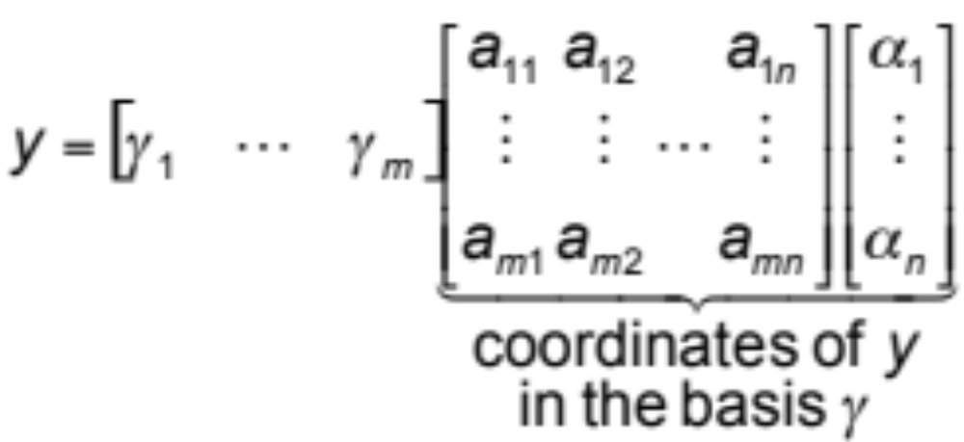
Model of a Linear Operator (7)
Substituting representation of y_{i} into y:
J.Y.Hung
ELEC 7500/6 State Variable Analysis

Slide 25
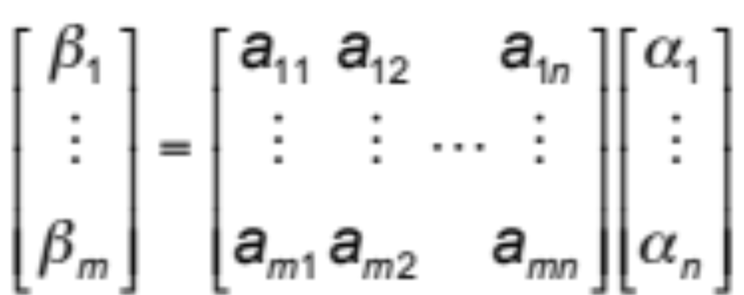
The New Coordinates
y has m coordinates β_{j}:
J.Y.Hung
ELEC 7500/6 State Variable Analysis

Slide 26
The Matrix Representation
y has m coordinates β_{j}:
Matrix of a_{ji} represents the operator
A: X ⇒ Y , i.e. (α_{i} ⇒ β_{j})
J.Y.Hung
ELEC 7500/6 State Variable Analysis

Slide 27
Summary: Linear Operator
y = A(x) is modeled by an m x n matrix A, i.e. β = Aα
A
X
Y
J.Y.Hung
ELEC 7500/6 State Variable Analysis

Slide 28
Operator Change of Basis (1)
Consider an operator A: X ⇒ X
For a given basis set {e_{i}}, the A is represented by an n x n matrix A.
y = A(x) is modeled by
β = Aα
J.Y.Hung
ELEC 7500/6 State Variable Analysis

Slide 29
Operator Change of Basis (2)
Q: What is the representation of A under a new basis {γ_{i}}?
J.Y.Hung
ELEC 7500/6 State Variable Analysis

Slide 30
Operator Change of Basis (2)
Q: What is the representation of A under a new basis {γ_{i}}?
Since both basis sets belong to X, one set can be expressed in terms of the other by a transformation P.
J.Y.Hung
ELEC 7500/6 State Variable Analysis

Slide 31
Operator Change of Basis (2)
Practical application: The model of a system depends on the coordinate system (basis set). If the coordinate system changes (new basis set), how does the model change?
Answer: There exists a coordinate transformation.
J.Y.Hung
ELEC 7500/6 State Variable Analysis

Slide 32
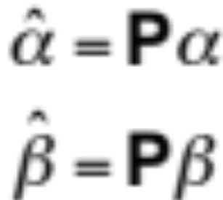
Operator Change of Basis (3)
New coordinates of x and y are related to the old coordinates by:
J.Y.Hung
ELEC 7500/6 State Variable Analysis

Slide 33
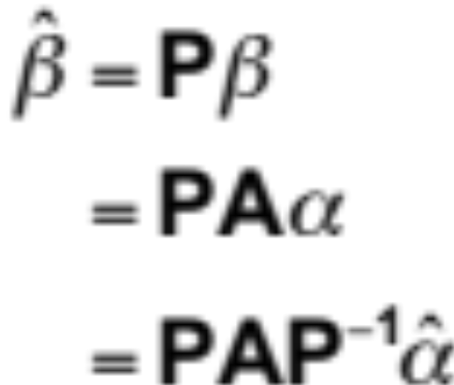
Operator Change of Basis (4)
Substituting:
J.Y.Hung
ELEC 7500/6 State Variable Analysis

Slide 34
Summary: Change of Basis
If new basis is related to the old basis by
γ = Pe
Then the new representation of A is:
Â = PAP⁻¹
P is called a similarity transformation.
J.Y.Hung
ELEC 7500/6 State Variable Analysis

Slide 35
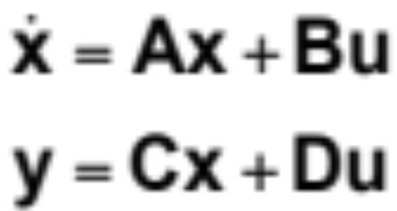
Applied to State Models (1)
Given a state variable model
J.Y.Hung
ELEC 7500/6 State Variable Analysis

Slide 36
Applied to State Models (2)
Given a state variable model
Consider a transformation of variables
z = Tx
J.Y.Hung
ELEC 7500/6 State Variable Analysis

Slide 37
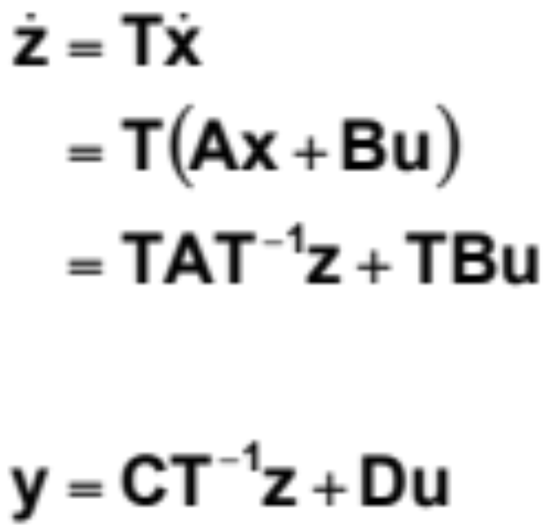
Applied to State Models (3)
The new state variable model
J.Y.Hung
ELEC 7500/6 State Variable Analysis

Slide 38
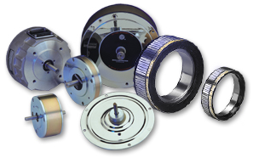
Example: DC Motor Model
J.Y.Hung
ELEC 7500/6 State Variable Analysis

Slide 39
Example: DC Motor Model
ω | speed (state variable)
i | armature current (state variable)
v | terminal voltage (input)
R | winding resistance
L | winding inductance
J | moment of inertia
B | friction coefficient
K | motor constant
J.Y.Hung
ELEC 7500/6 State Variable Analysis

Slide 40
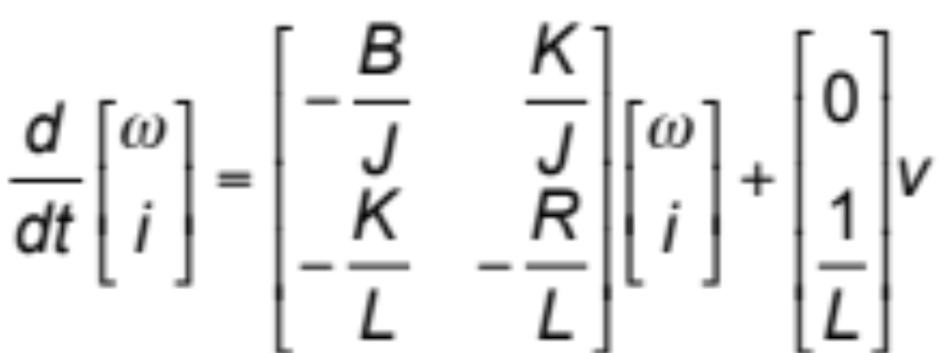
Example: DC Motor model
State variable model
J.Y.Hung
ELEC 7500/6 State Variable Analysis

Slide 41
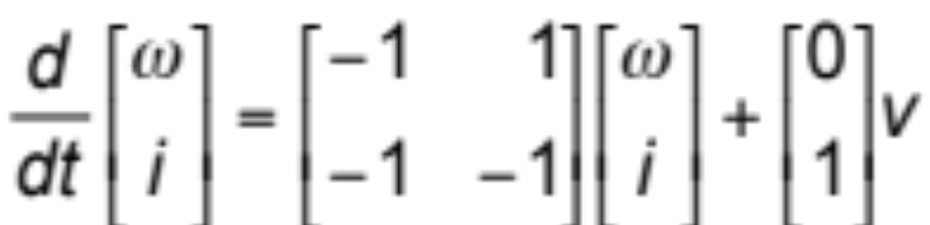
Example: DC Motor model
If all parameter values = 1
J.Y.Hung
ELEC 7500/6 State Variable Analysis

Slide 42
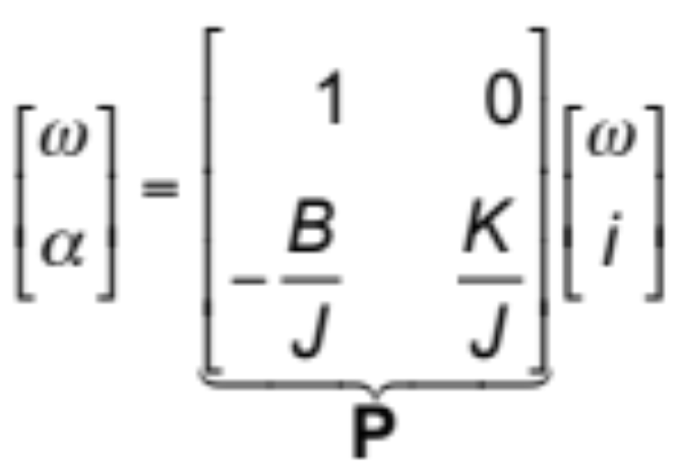
Example: DC Motor model
Consider new state variables: acceleration α and speed ω
J.Y.Hung
ELEC 7500/6 State Variable Analysis

Slide 43
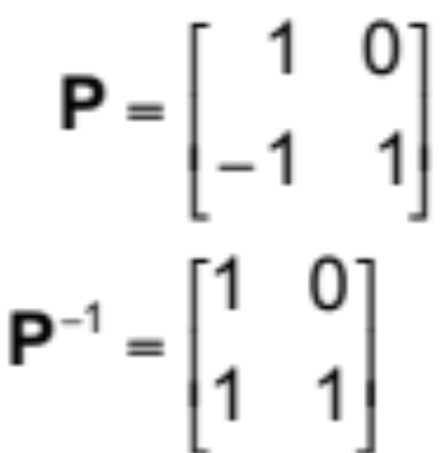
Example: DC Motor model
If all parameter values =1
J.Y.Hung
ELEC 7500/6 State Variable Analysis

Slide 44
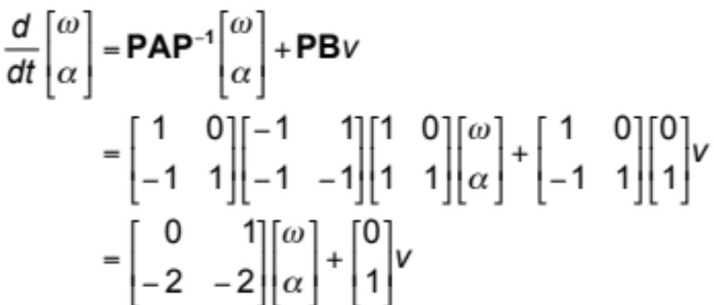
Example: DC Motor model
Result: a model in canonical form
J.Y.Hung
ELEC 7500/6 State Variable Analysis
Notes:
Model is in controllable canonic form.

Slide 45
Homework (2003)
Read Brogan, Sections 5.9, 5.11
J.Y.Hung
ELEC 7500/6 State Variable Analysis

